Slide 1
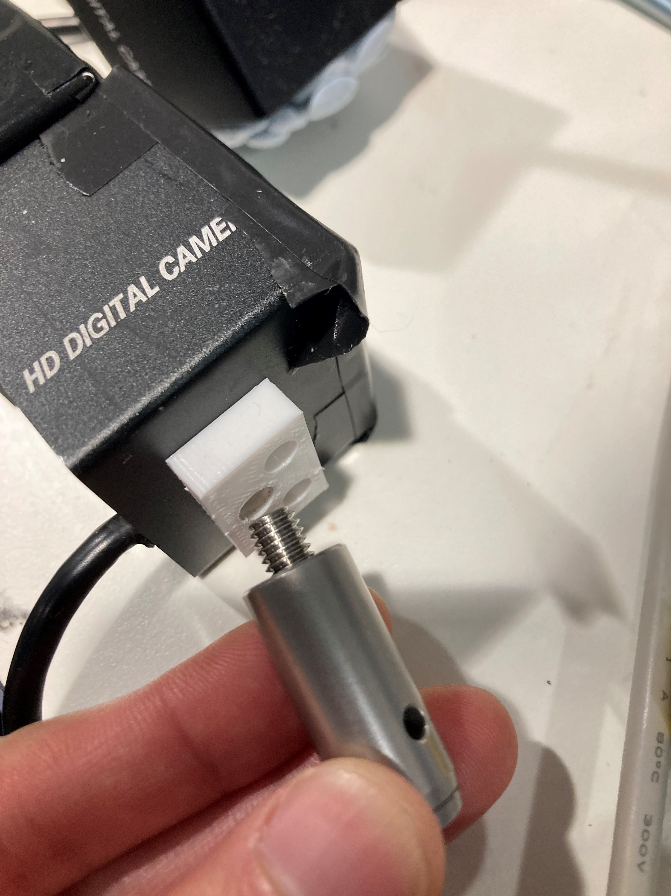
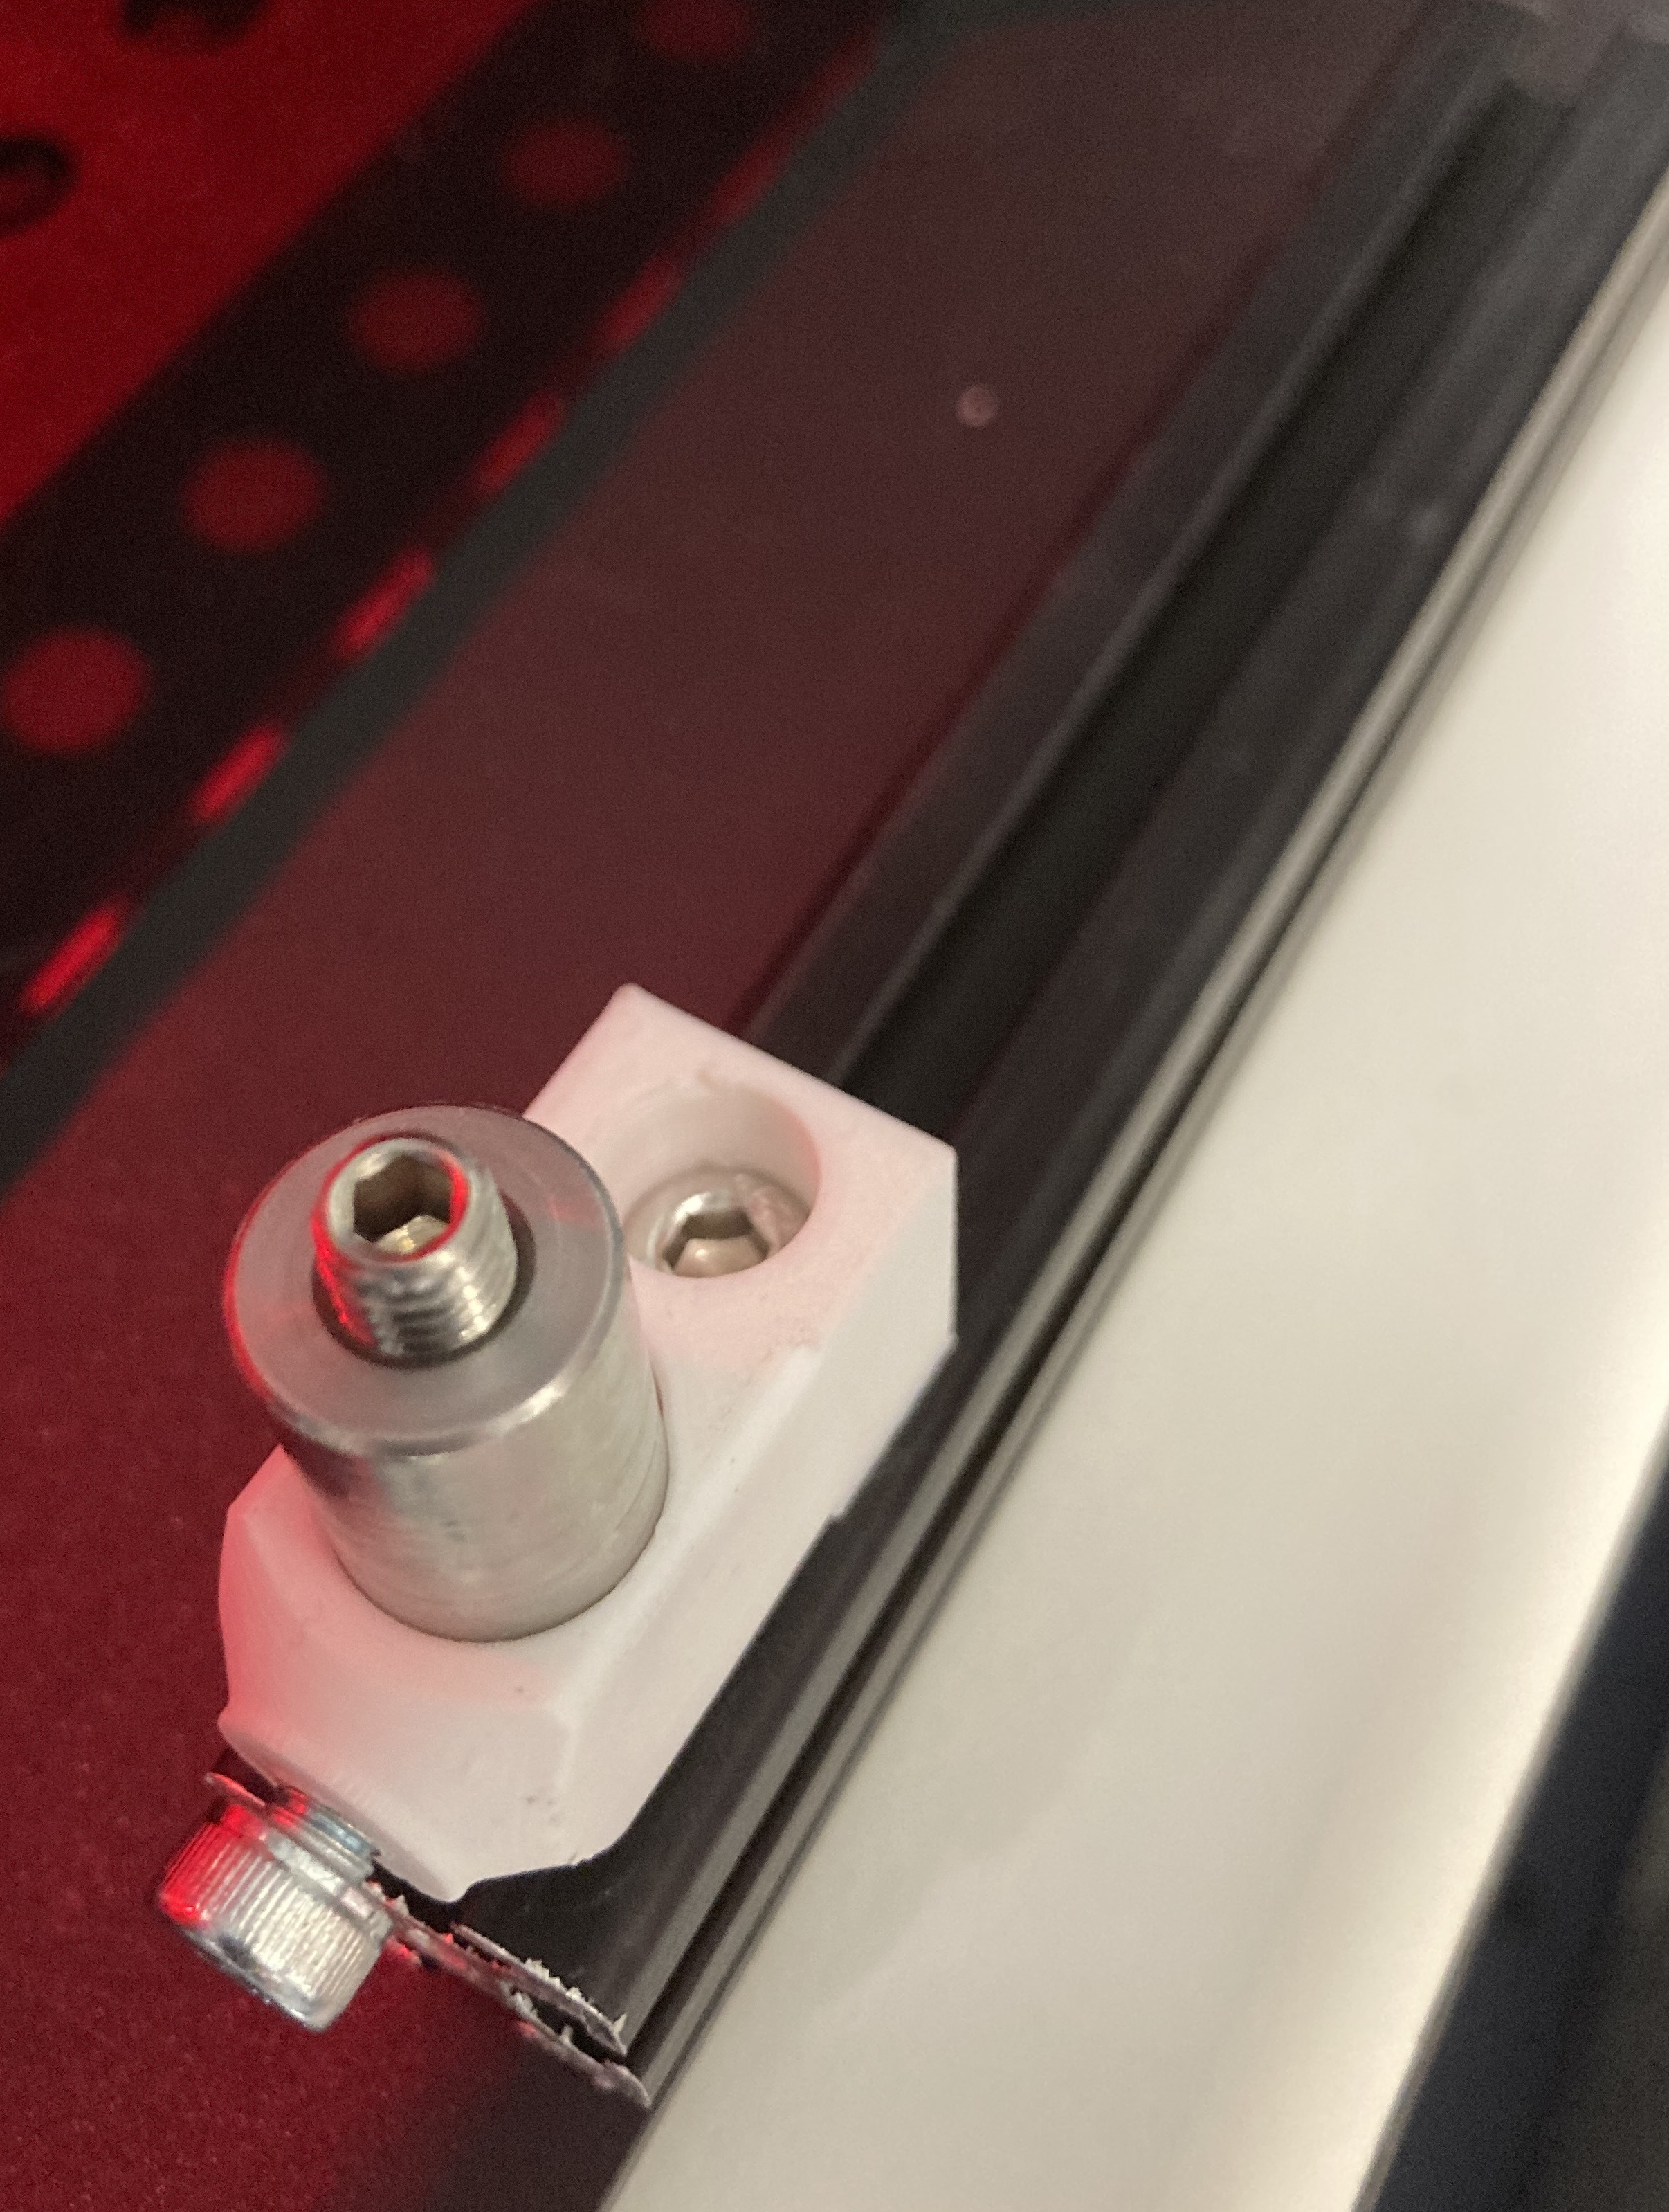
RA180
cam M6
replacement
M5 Tslot nut (not visible)
camera
M6 setscrew
TR30/M
M5 x 10mm
M5 x 6mm

